Slide 1

Twitter Data Analysis

Slide 2

Challenge
Time: 2 days
The Problem
Customer support now a days became quick and natural in channels like Twitter and Facebook where uses request for help, support or show their disappointment with larger audience. The data in such channels are Focused , Natural and Succinct.
Negative review in such channels can greatly impact the sales, profitability and customer experience.
The Challenge
Can we do topic clustering to find related topics? Can we improve campaigns run on this social media by this insights?
Can we identify how many customers are unhappy and why are they unhappy about?
The Objective
Insights: Apply one or more machine learning algorithm (Supervised or unsupervised) to solve the problem and showcase the same in a presentation format, also upload the code on GitHub in jupyter notebook format and provide the link
Solution
Kaggle kernel (please visit the solution here as notebooks contains interactive plots): https://www.kaggle.com/mohitkag/nlp-twitter-sentiment-analysis
Github link: https://github.com/git-mohit/NLP-Twitter-Customer-Reviews-Analysis

Slide 3

Customer Sentiment Analysis and Topic Modelling on Twitter Data
We need to carefully monitor customer’s sentiment in all communications between our support engineers and customers.
This project will focus on the task “track customer’s satisfaction level over times and give action suggestions”.
Original dataset includes support data from multiple companies. Here we choose one of the companies for instace 'Sprintcare' in this case in order to focus on smaller data chunk with customers of specific company.
The twitter data had the below information:
tweet_id
The unique ID for this tweet
author_id
The unqiue ID for this tweet author
inbound
Whether or not the tweet was sent (inbound) to a company
created_at
When the tweet was created
text
The text content of the tweet
response_tweet_id
in_response_tweet_id

Slide 4

Use Case 1 :
Calculate average sentiment values for each customer over this data chunk and compare to predefined alert threshold.
If the average sentiment value is lower than the threshold we'll list all the customers(author_id)
Suggest to reach to them for further discussion to find the reason and resolve the issues proactively
Steps:-
Load the data
Filter the data for inbound and sprintcare company
Remove duplicates
Text preprocessing
(cleaning->tokenize->POS tag->lemmatize)
Sentiment scoring
(NLTK vader sentiment analyzer)
Grouping and averaging customers sentiments
Output
Ordered list of customers with negative avg sentiment score
Viz. for distribution and five point summary box plot of customers sentiments.

Slide 5
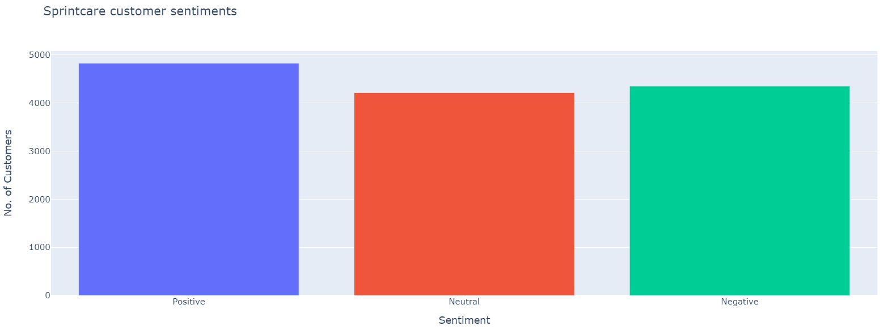

Slide 6
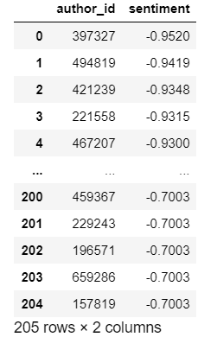
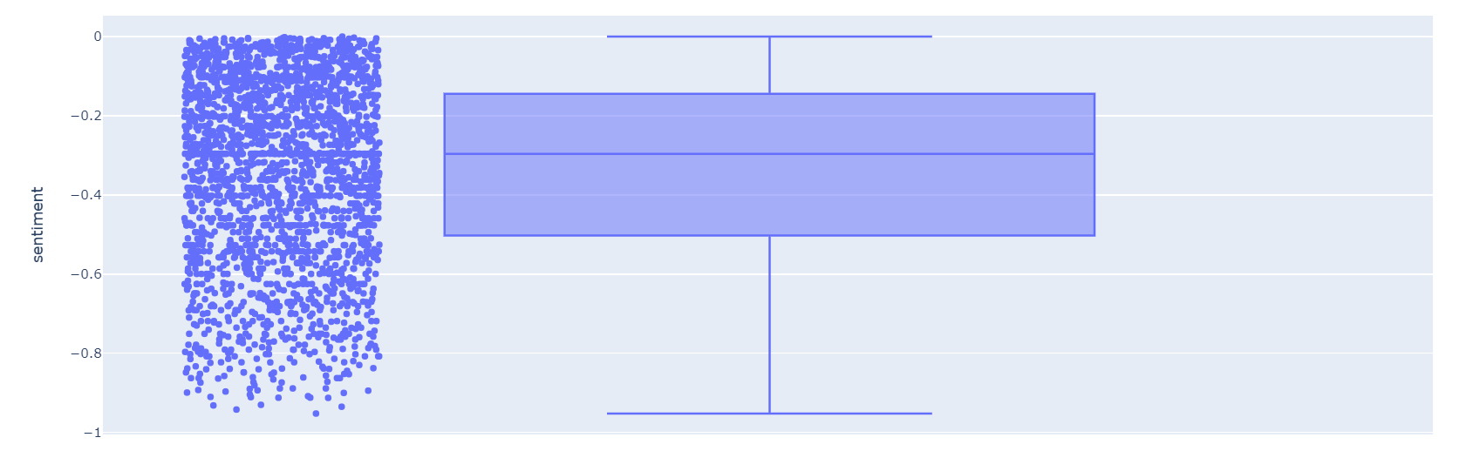
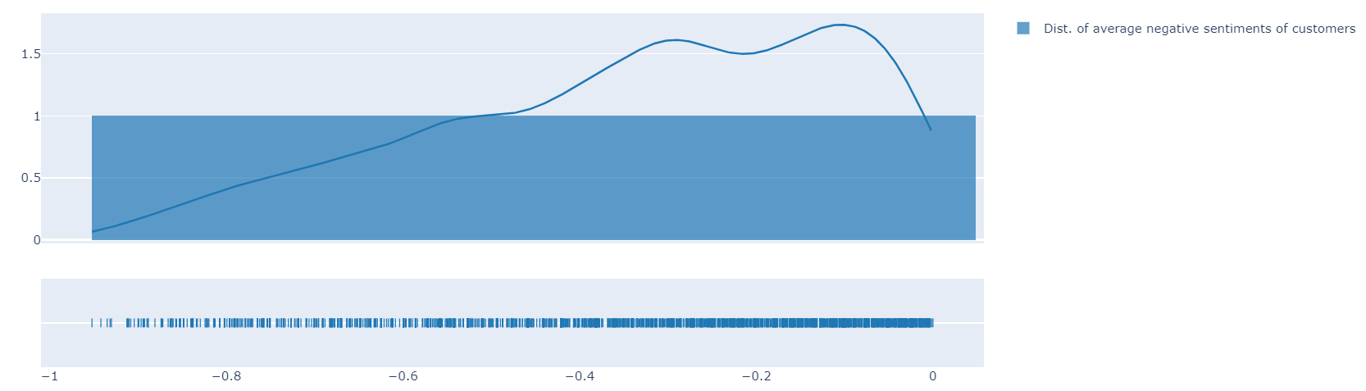
List of Customers with avg. Sentiment scores below threshold

Slide 7
Use Case 2 :
Calculate minimum sentiment values for each customer over this data chunk and compare to predefined alert threshold.
If the minimum sentiment value is lower than the threshold we'll list all the customers(author_id)
Suggest to reach to them for further discussion to find the reason and resolve the issues proactively
Steps:-
Load the data
Filter the data for inbound and sprintcare company
Remove duplicates
Text preprocessing
(cleaning->tokenize->POS tag->lemmatize)
Sentiment scoring
(NLTK vader sentiment analyzer)
Grouping and aggregating for min. customers sentiment scores
Output
Ordered list of customers with minimum negative sentiment score
Viz. for distribution and five point summary box plot of customers sentiments.

Slide 8
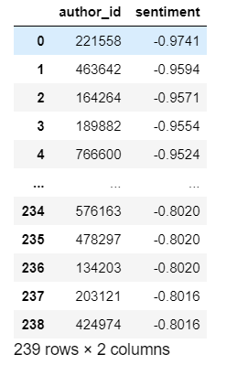
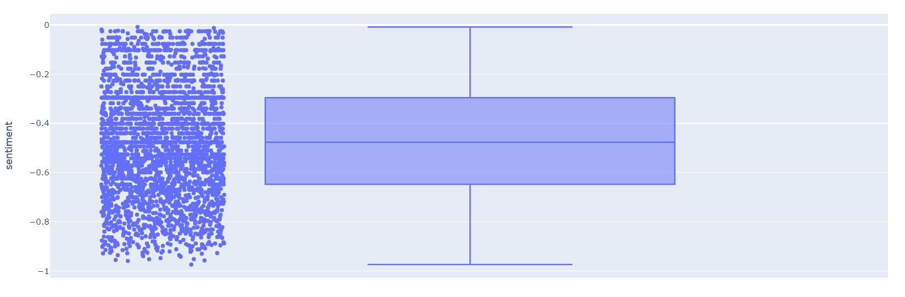
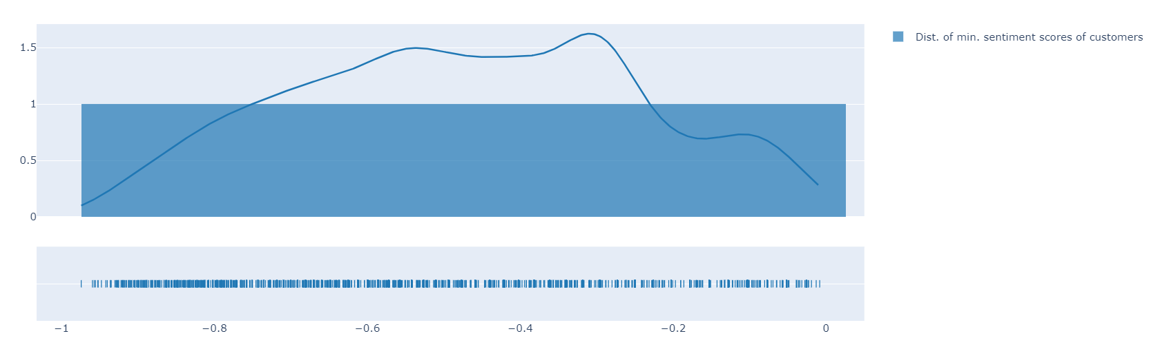
List of Customers with min. Sentiment scores below threshold

Slide 9
Use Case 3
Topic Modelling
Topic Modelling to map similar customers' messages to a specific topic.
This would provide a quick view of the about the issue customers most talking about and also group the customers with similar issues under one topic.
As a result of this use case various vizualtions are built like topic distribution, frequency distribution of words, bigrams, trigrams, sentiment polarity, pyLDAvis, wordcloud, t-SNE for one topic.
Also an interactive tool is generated to see all the above plots with respect to specific topic on demand.
Modelling algorithm used is LDA after basic text preprocessing.

Slide 10
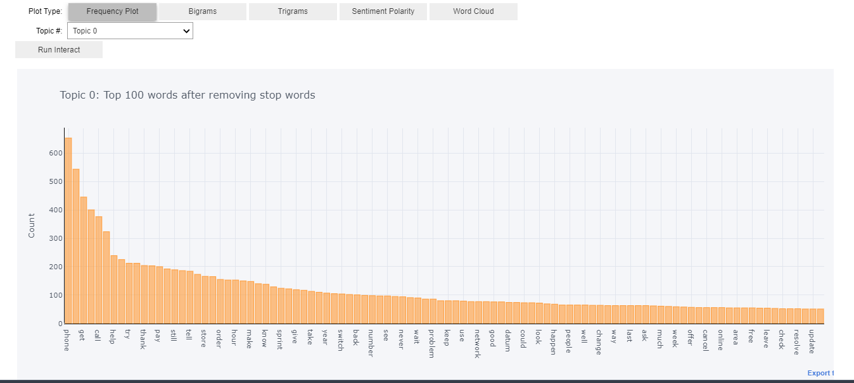

Slide 11
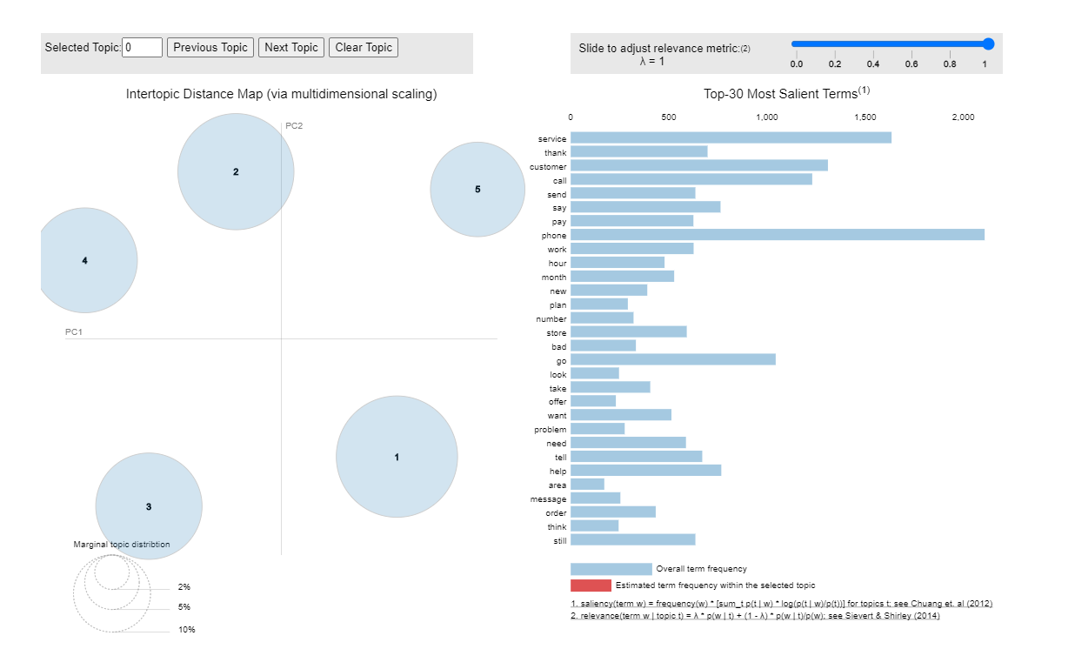

Slide 12
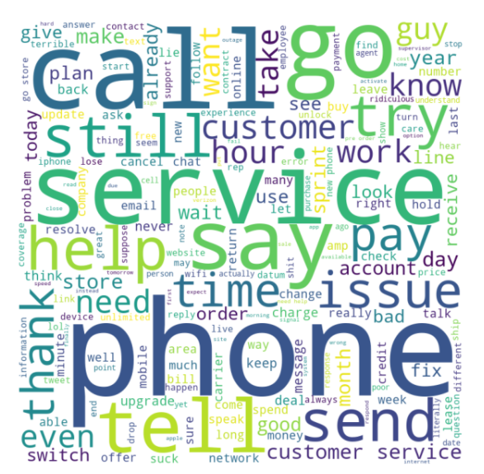
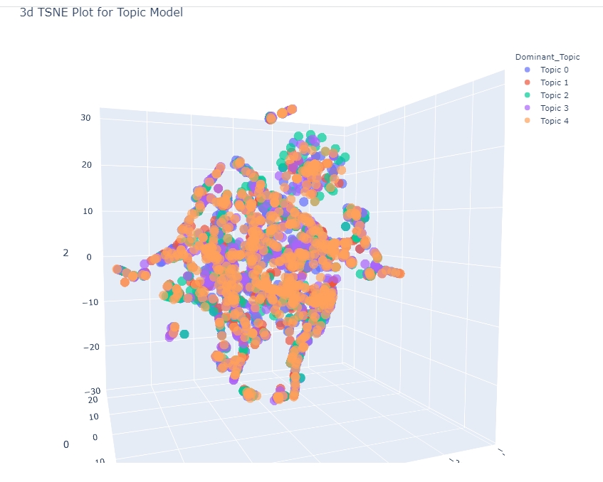

Slide 13
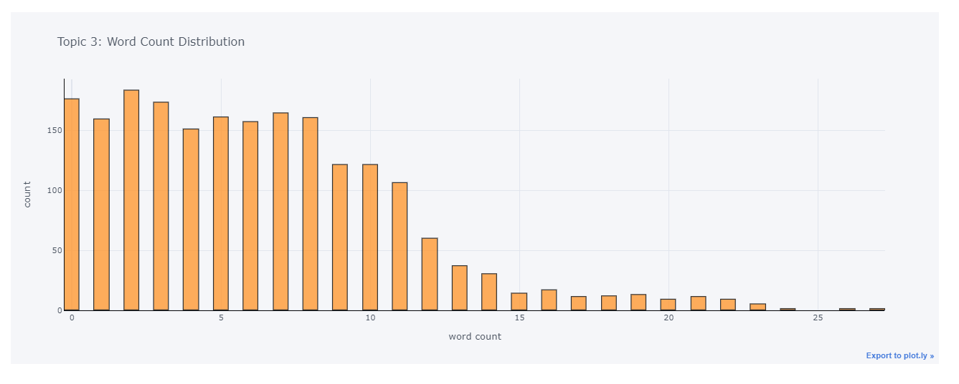
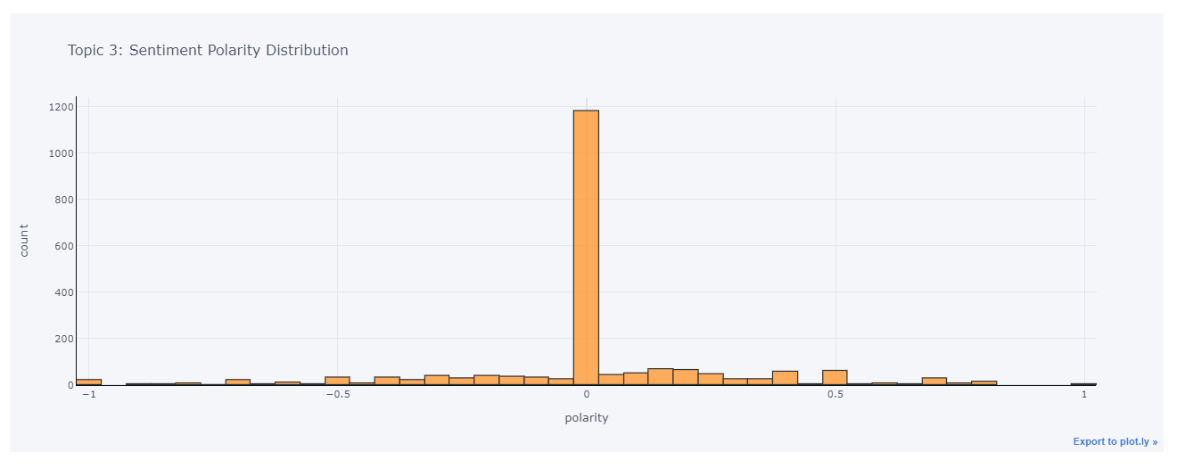

Slide 14
Value Propositions and Action Items
Comprehensive twitter data analytics for customr reviews lends the following insights to arrive at the business decisions.
Visualize the distribution of negative sentiment score to monitor whether or not customers negative sentiments are shifting towars neutral or positive sentiments with time.
List of customers ordered with decreasing negative sentiment scores to take prompt action and look into their grievances.
Topic modelling providing a quick view of customers' issues and categorising those into defferent topics.

Slide 15
Scope of Further Analysis and Improvements
Analysis of twitter data for other brands/company and comparing sentiments of customers among them.
Using other sentiment scoring algorithm like textblob, Afinn, etc and comparing the results for consistency.
Using other modelling techniques like ‘hdp’: Hierarchical Dirichlet Process‘rp’: Random Projections, ‘nmf’: Non-Negative Matrix Factorization, etc. and evaluating the models.
Building a classification model once we have labelled data which is manually verified to classify the tweets based on customers' sentiments.

Slide 16
Thank you

